Slide 1

GOOD MORNING
EVERYONE

Slide 2

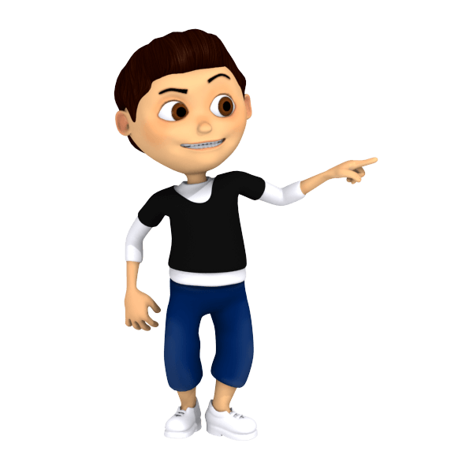
CYBER SECURITY

Slide 3

1. STRENGTH
PROBLEM SOLVING
RISK MANAGEMENT
LEADERSHIP QUALITY

Slide 4

2. WEAKNESS
This Photo by Unknown Author is licensed under CC BY
CODING
COMMUNICATION SKILLS

Slide 5

3. OPPORTUNITY
CHANCE TO SERVE THE COUNTRY
TO BECOME A RAW AGENT

Slide 6

4. THREAT
SHORT TEMPER ATTITUDE
IMPATIENCE
HACKERS

Slide 7


